Slide 1

EARLY DETECTION OF ALZHEIMER’S DISEASE USING CNN DEEP LEARNING
Under the Guidance of: Prof. Disha Wankhede
Roll No. | Name | PRN
324021 | Sarvesh Hajare | 22110702
324052 | Aditya Rokamwar | 22110765
324060 | Himanshu Suryawanshi | 22110300
324061 | Suyash Phapale | 22110445

Slide 2
Introduction to Alzheimer's Disease
Alzheimer's disease is a neurodegenerative disorder that causes memory loss and cognitive decline. Early detection of Alzheimer's is crucial for effective treatment and care.
Mild Cognitive Impairment (MCI) is a critical stage preceding AD, and early detection is crucial for preventing further progression. Structural MRI is a valuable tool for predicting AD, especially in the MCI stage, as it provides detailed anatomical information about atrophy regions in the brain.

Slide 3
Objective of the Project
The objective of this project is to develop and compare three CNN models for Alzheimer's disease classification. The models aim to accurately classify brain MRI images as either belonging to Alzheimer's patients or healthy individuals.

Slide 4
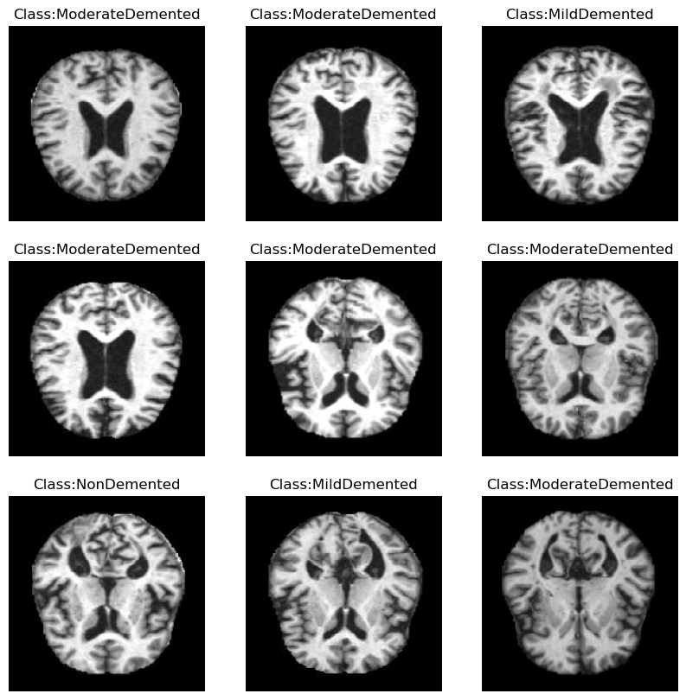
Dataset Description
The dataset consists of brain MRI images collected from Alzheimer's patients and healthy individuals. The dataset was preprocessed to enhance image quality and normalize pixel values.
Normal Control (NC): These images are from individuals without any cognitive impairments or neurodegenerative diseases. They serve as a baseline for comparison.
Mild Cognitive Impairment (MCI): These images are from individuals who exhibit mild cognitive decline, which may indicate early stages of AD.
Alzheimer's Disease (AD): These images are from individuals diagnosed with Alzheimer's disease, showing significant brain atrophy and other structural changes compared to NC.

Slide 5
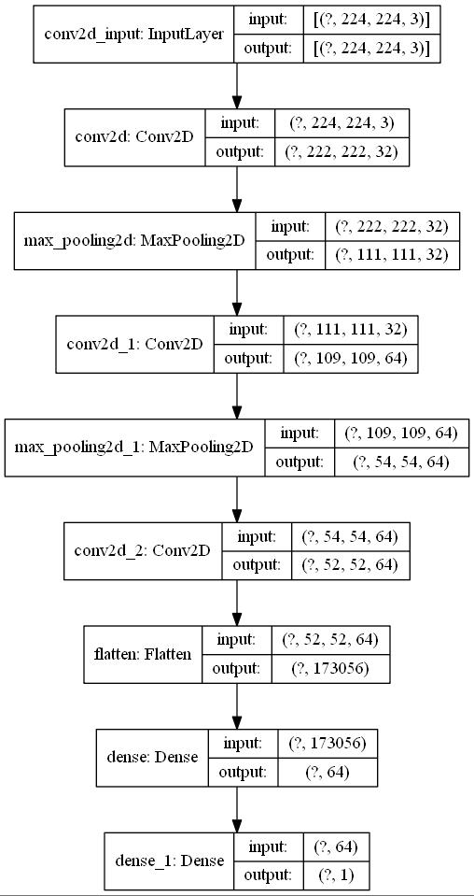
EfficientNetB0 Model
Architecture: EfficientNetB0 is a convolutional neural network architecture that uses efficient building blocks to achieve high accuracy with fewer parameters.
Accuracy: The model achieved an accuracy of 85.46% on the test dataset.

Slide 6
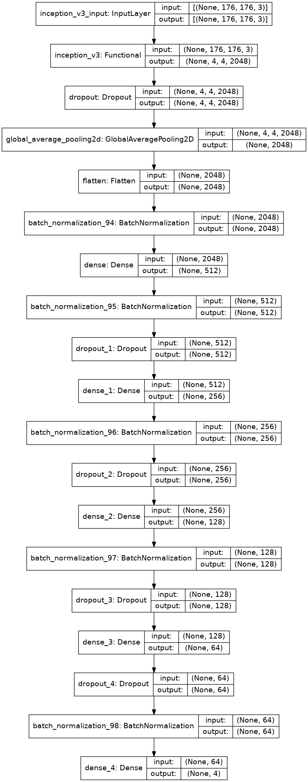
Inception V3 Model
Architecture: Inception V3 is a convolutional neural network architecture that uses inception modules for better feature extraction.
Accuracy: The model achieved an accuracy of 89.06% on the test dataset.

Slide 7
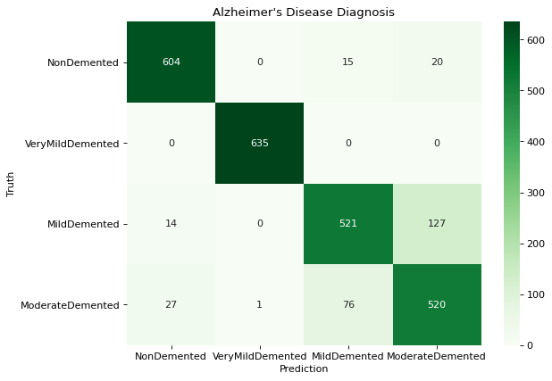
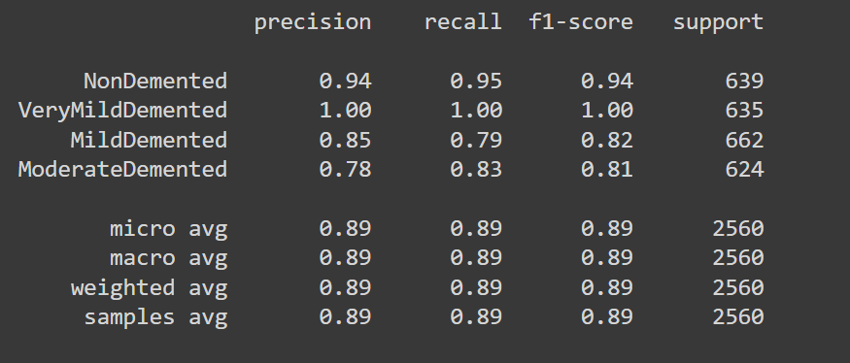
Confusion Matrix - Inception V3

Slide 8
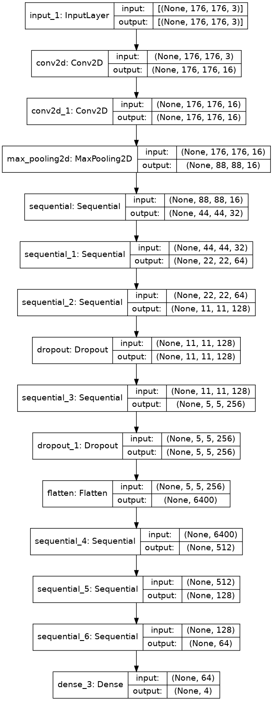
Custom CNN Model
Architecture: The custom CNN model was designed specifically for this project, with a focus on capturing intricate patterns in MRI images.
Accuracy: The model achieved an accuracy of 94.84% on the test dataset.

Slide 9
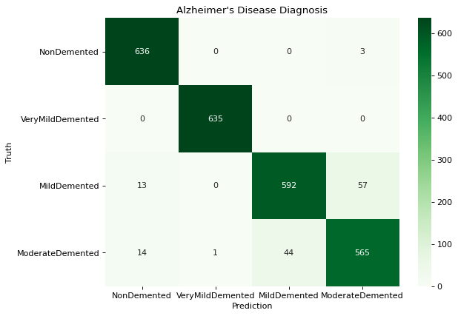
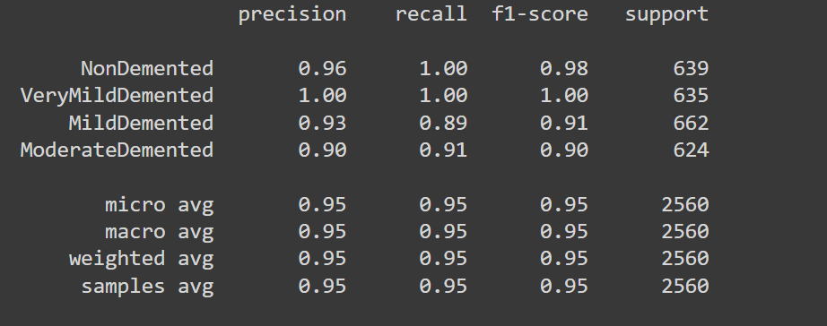
Confusion Matrix - Custom CNN

Slide 10
Comparison of Models
Accuracy Comparison:
Model | Accuracy (%)
EfficientNetB0 | 85.46
InceptionV3 | 89.06
Custom CNN | 94.84

Slide 11
Conclusion
The custom CNN model outperformed EfficientNetB0 and Inception V3 in terms of accuracy. However, EfficientNetB0 and Inception V3 also achieved respectable accuracies and can be considered for use in certain scenarios. Further research could focus on ensemble methods to combine the strengths of all three models.

